Slide 1


2019
Department
Of Computer
Science
&
Electrical And
Electronics
Engineering
MATH-IV
KAS -402
2020-2021
Dr.Rupa Sharma
Associate Professor
vsrsrsys@gmail.com
Notes:
Thisv is Cover page

Slide 2
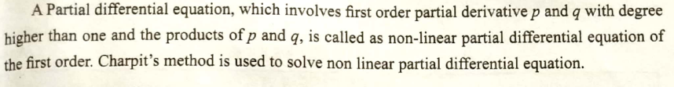

Slide 3
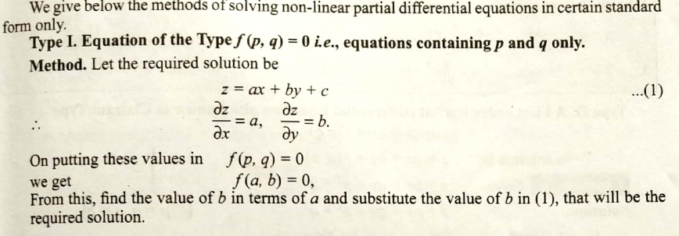

Slide 4

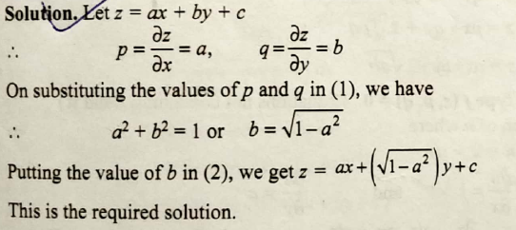
EXAMPLE 1:

Slide 5
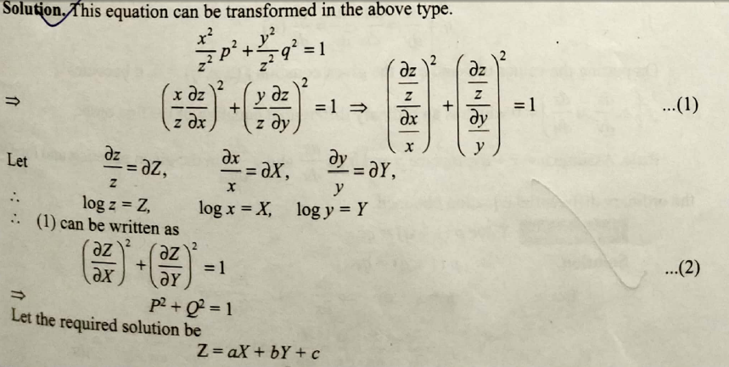
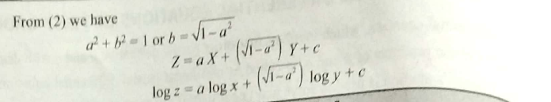
EXAMPLE 2:

Slide 6
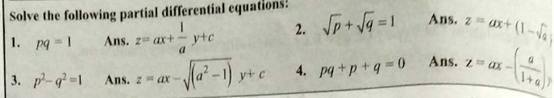
HOME WORK

Slide 7
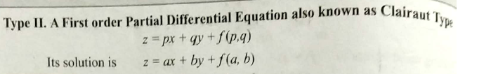
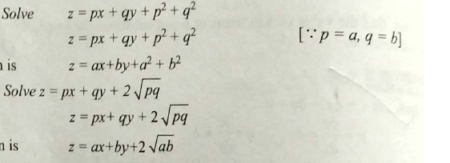
EX1:
EX2:

Slide 8
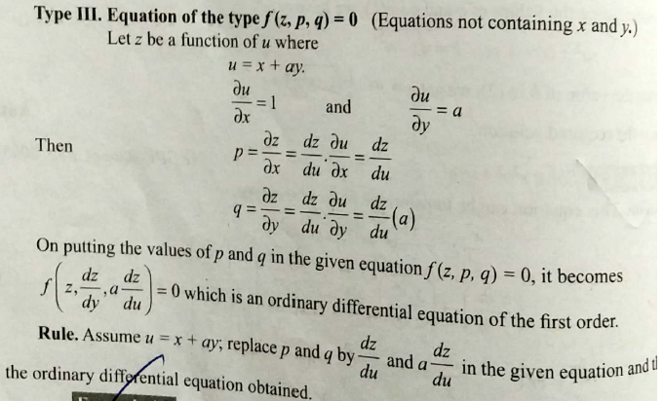

Slide 9
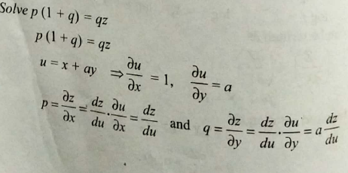
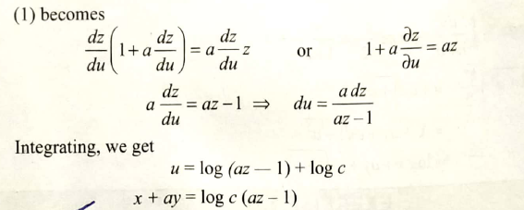

Slide 10
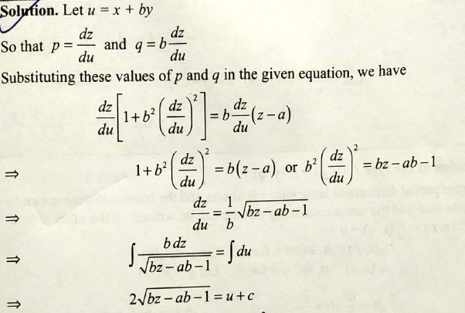


Slide 11

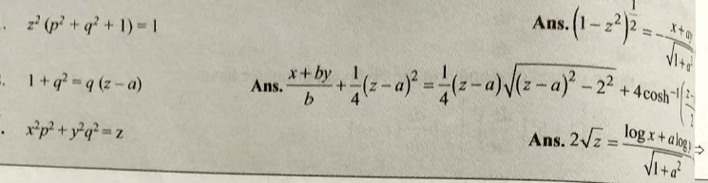
HOME WORK

Slide 12
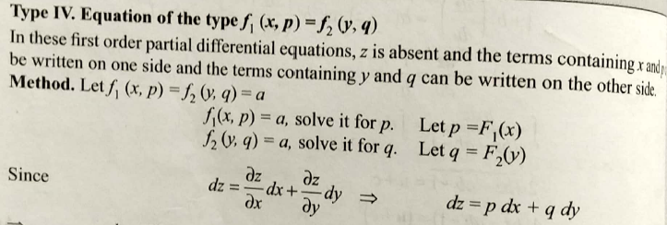

Slide 13

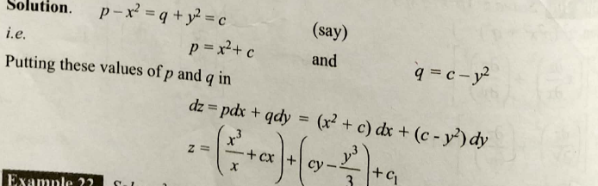
Example 1:

Slide 14

HOME Work

Slide 15
THANK YOU

